Slide 1
Dr.SNS RAJALAKSHMI COLLEGE OF ARTS AND SCIENCE
(AUTONOMOUS)
Accredited by NAAC (Cycle-III) with ‘A+’ Grade
Department of Mathematics
COURSE: FUZZY LOGIC AND NEURAL NETWORKS
Topic: LOGIC AND CONNECTIVES
S.REKHA
Assistant Professor
Dept. of Mathematics
Dr. SNSRCAS

Slide 2
LOGIC CONNECTIVES
The Five (5) Common Logical Connectives or Operators
Negation
Conjunction (AND)
Disjunction (Inclusive OR)
Implication (Conditional)
Biconditional (Double Implication)

Slide 3
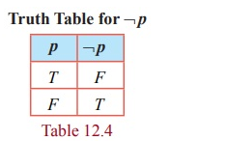
I. Truth Table of Logical Negation
The negation of a statement is also a statement with a truth value that is exactly opposite that of the original statement. For instance, the negation of the statement is written symbolically as

Slide 4
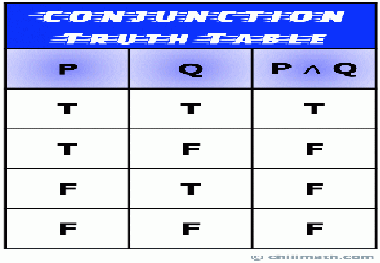
Truth Table of Logical Conjunction
A conjunction is a type of compound statement that is comprised of two propositions (also known as simple statements) joined by the AND operator.

Slide 5
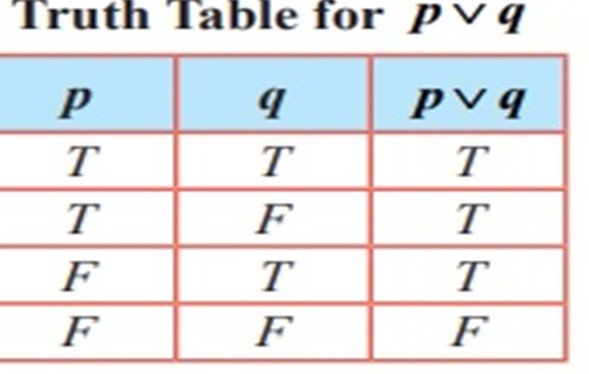
Truth Table of Logical Disjunction
A disjunction is a kind of compound statement that is composed of two simple statements formed by joining the statements with the OR operator.

Slide 6
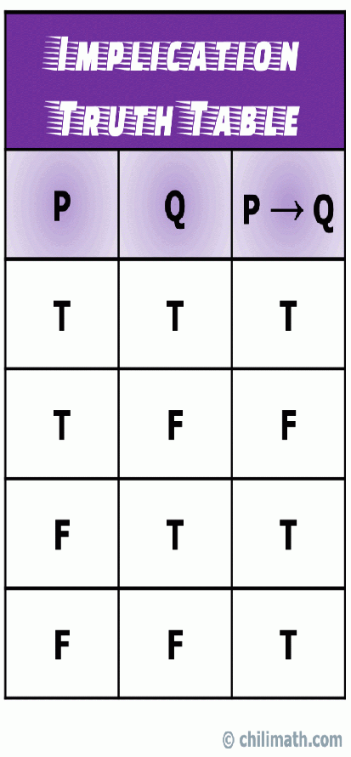
Truth Table of Logical Implication
An implication (also known as a conditional statement) is a type of compound statement that is formed by joining two simple statements with the logical implication connective or operator.

Slide 7
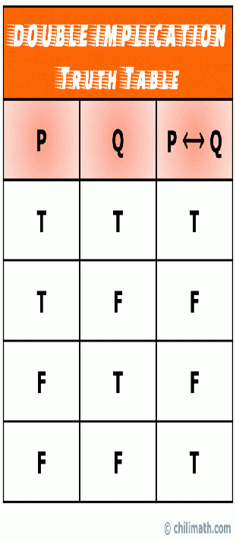
Truth Table of Logical Biconditional
A double implication (also known as a biconditional statement) is a type of compound statement that is formed by joining two simple statements with the biconditional operator.

Slide 8
THANK YOU

